Slide 1
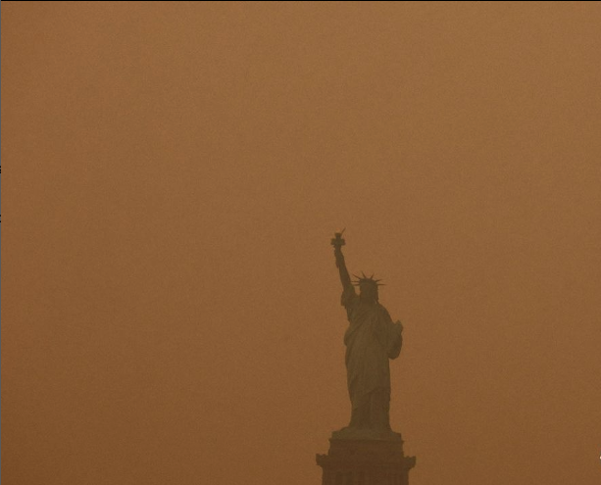
Group 3: Project 4:
Air Quality
Data Model Implementation
& Data Model Optimization
Garrett Bradley
Jessica Van Dame
Katie Bienek
Sam Song
Rachel Novak
Notes:
Rachel + Running slides

Slide 2
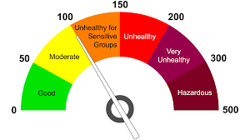
Our Process
The Air Quality Index (AQI) is used for reporting daily air quality. It tells you how clean or polluted your air is, and what associated health effects might be a concern for you.
Selection Issue & Data
Purpose: One of our members is under and Air Quality Advisory as of now; turns out it is the worst Air Quality Report in decades. Seems as if these things are getting more and more common.
Selected initial data set, realized more information was needed after inputting initial data.
We took a step back and returned to Kaggle for a new data set with 32K+ lines of data; with 12 columns of features.
We could use our project to raise awareness about air pollution and support initiatives to improve air quality monitoring, management and technology.
Notes:
Rachel

Slide 3

Our Process
Split, Train and Model data
Defined selected features and target vectors
Features were the Emissions AQI Values
Target Vector was the AQI Category
Split data into training and testing sets
Scaled the data for consistency; with using StandardScaler from sklearn.preprocessing
Applied Random Forest Regression algorithm to the model
Made predictions using the trained model and random forest classifier with 500 trees.
Notes:
Katie

Slide 4
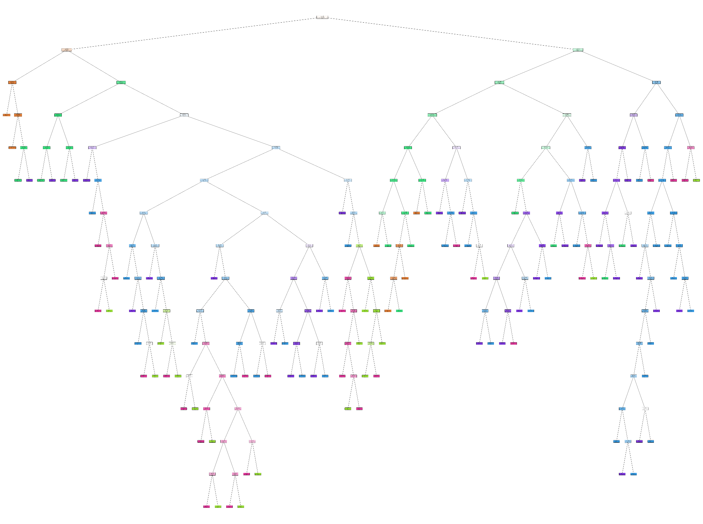
Random Forest
Notes:
Garrett

Slide 5
Our Process
Correlation Matrix
 | AQI Value | CO AQI Value | Ozone AQI Value | NO2 AQI Value | PM2.5 AQI Value
AQI Value | 1.000000 | 0.430602 | 0.405310 | 0.231758 | 0.984327
CO AQI Value | 0.430602 | 1.000000 | 0.145724 | 0.488092 | 0.438557
Ozone AQI Value | 0.405310 | 0.145724 | 1.000000 | -0.181818 | 0.339887
NO2 AQI Value | 0.231758 | 0.488092 | -0.181818 | 1.000000 | 0.260127
PM2.5 AQI Value | 0.984327 | 0.438557 | 0.339887 | 0.260127 | 1.000000
Evaluate model
Employed confusion matrix for performance evaluation
Revisited correlation matrix for further analysis
Achieved impressive accuracy of 99%
Analyzed importance of selected features
**AQI Value - Overall AQI value of the city
** CO AQI Value - AQI value of Carbon Monoxide of the city
** Ozone AQI Value : AQI value of Ozone of the city
** NO2 AQI Value : AQI value of Nitrogen Dioxide of the city
** PM2.5 AQI Value : AQI value of Particulate Matter with a diameter of 2.5 micrometers or less of the city
Notes:
katie

Slide 6
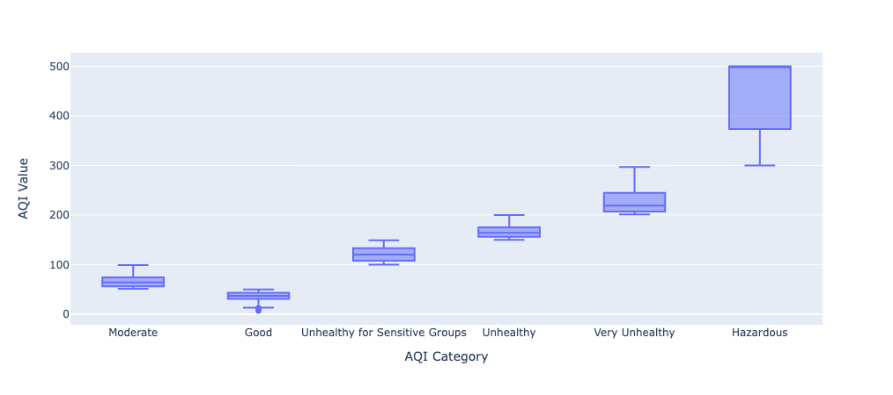
AQI Value to AQI Category Comparison
Notes:
Jessica

Slide 7
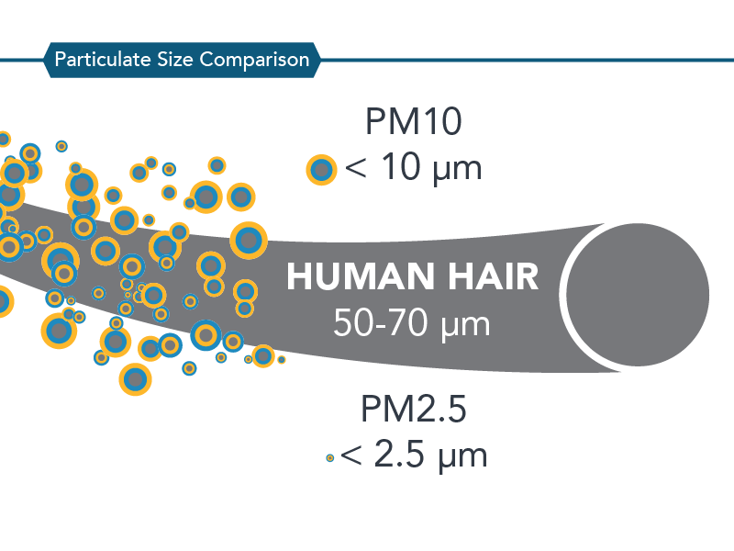
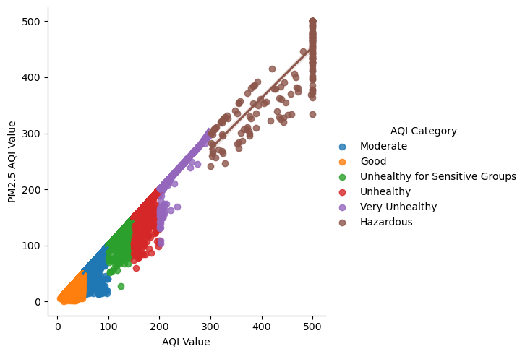
Particle Size PM2.5 AQI
Notes:
Jessica

Slide 8
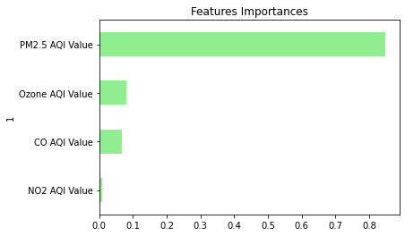
Our Process
Data Visualization
Analyzed NO2 as the least important feature from the set and dropped it from the dataset copy.
Model maintained the same 99% accuracy even after removing NO2 AQI Value
Generated various data visualizations such as box and whisker plots, scatter plots, and decision trees in the analysis.
Notes:
Sam

Slide 9
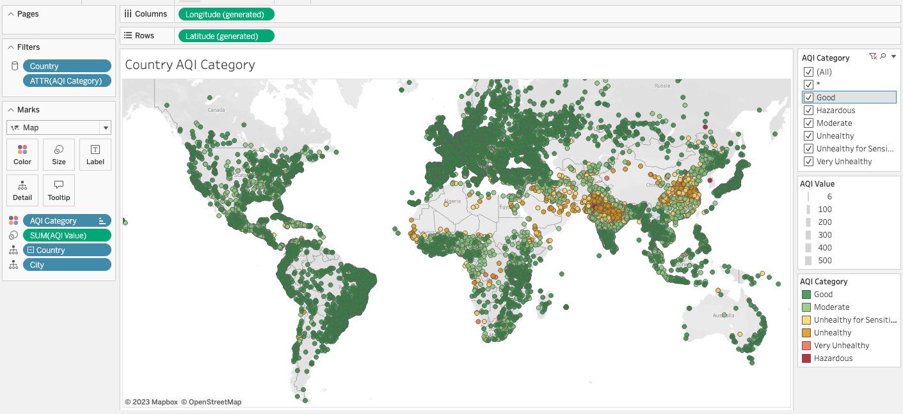
AQI Value Filtered by Category Comparison
Notes:
Rachel

Slide 10
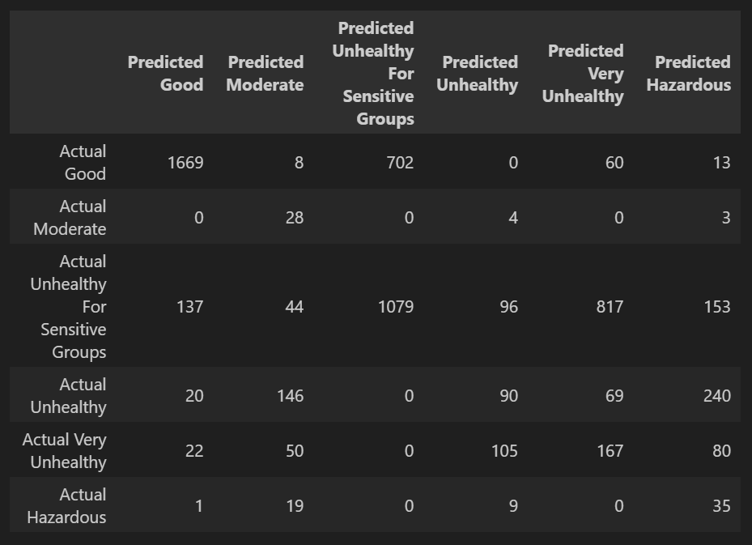
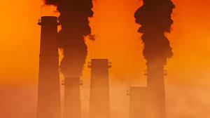
We Tried Logistic Regression…OOF!
Balanced Accuracy Score = 50.7%
Notes:
Garrett

Slide 11

Did we use the data for anything?
Yes, we tried to source and run an additional data set. This small data set had roughly 100 cities that we tried to feed into the model.
We saved our model with .pkl for a pickle file using joblib library
Tried running the data through the set and just kept running into errors left and right at each new attempt and ran outta time.
Air-ors
Notes:
Sam

Slide 12
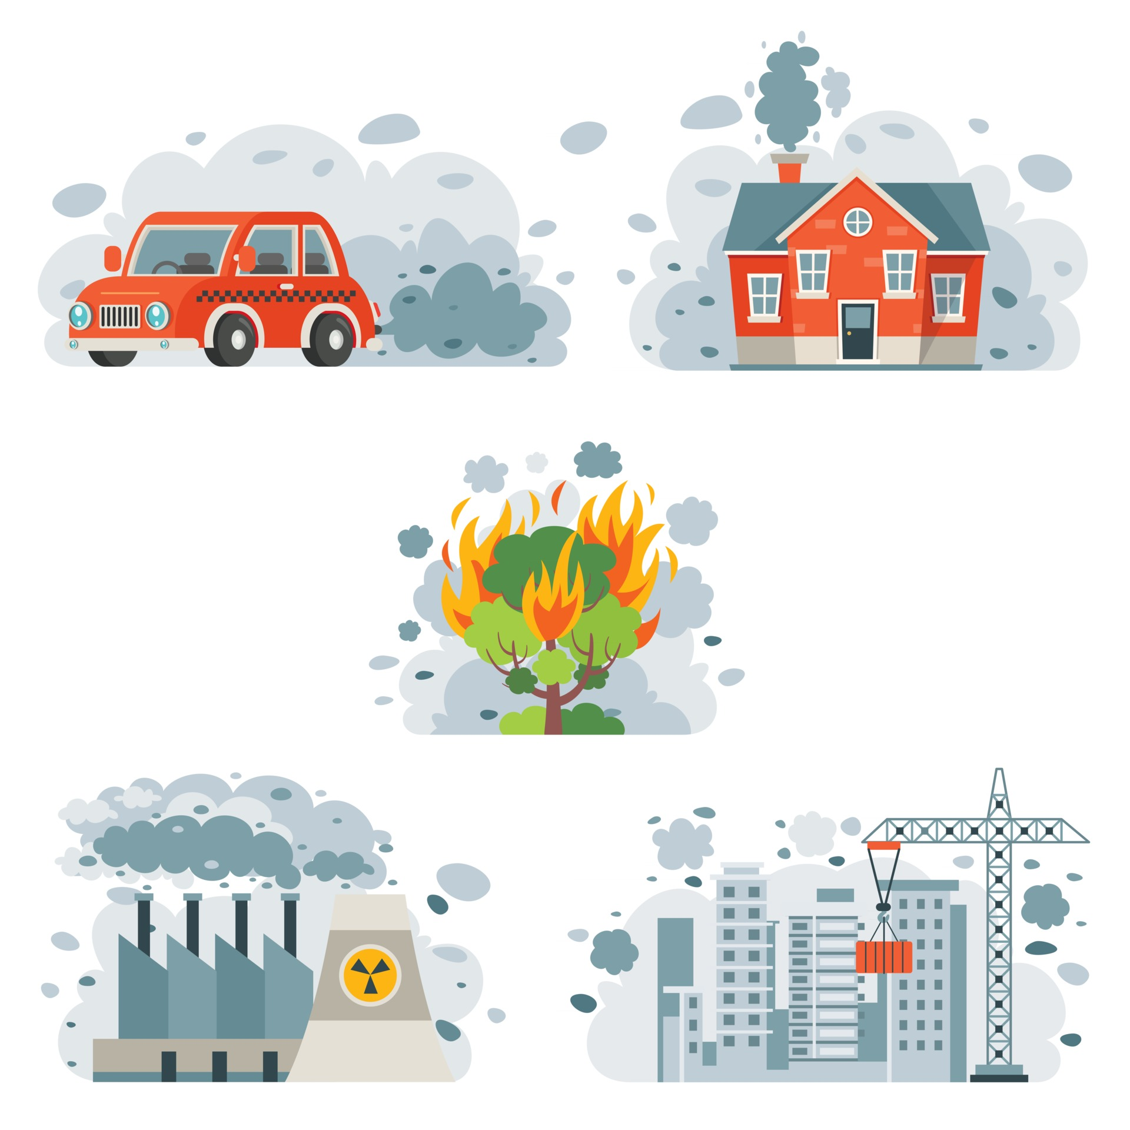
Any Questions?
Garrett Bradley
Jessica Van Dame
Katie Bienek
Sam Song
Rachel Novak
Notes:
Sam

